Slide 1
Portfolio

Slide 2
Digital portfolio
STUDENT NAME: JANASTY D REGISTER NO AND NMID:AB6CB1E32904A01952F4D09A19235 DEPARTMENT: BSC(COMPUTER SCIENCE COLLEGE: OM SHANTI ARTS AND SCIENCE COLLEGE

Slide 3
TAGE
Html> <head> </head> (USED TO GIVE A HEADING) <title></title> (USED FOR A TITLE) > <style> </style> (USED FOR DESIGN THE PAGE) <link> <link (USED TO COMBINE MULTIPLE PAGES) ▸ <body></body> (THE GIVEN DETAILS WAS DISPLAY IN OUTPUT) <header> </header> (DISPLAY THE WORDS AS SPECIFY THE HEADING) <div> </div> (USED TO GIVE A CLASS NAME) <button> </button> (TO RUN A SPECIFY TASK) <section> </section> (USED TO RUN A SPECIFY TASK)

Slide 4
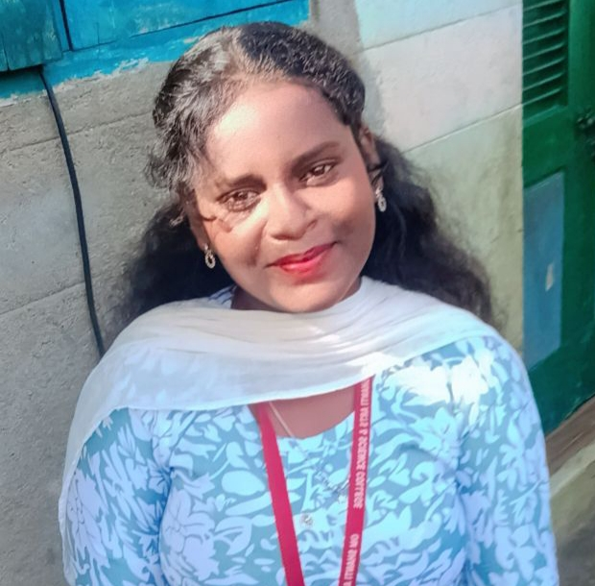
ABU
Hello! I’m an undergraduate Computer Science student specializing in Computer Science. I am passionate about building system works that can solve real-world problems, from natural language processing to computer vision. I enjoy experimenting with neural networks and data-driven solutions.

Slide 5
CONTACT
Email: janastyjeba@gmail.com Phone: 6384703392 Location: Muthu street, mannur, Kanchipuram.

Slide 6
SKILL &LANGUAGE
SKILLS: HTML, CSS, JavaScript Python, React, Data Structures. LANGUAGES: ENGLISH (Fluent), TAMIL (Native).

Slide 7
PROJECTS
Project One –
STUDENT ID-CARD CREATING BASIC ID-CARD FOR STUDENT. HTML, CSS, JavaScript Project Two –
COLLEGE TIME-TABLE STUDENT REGULAR DAY ORDER TIME-TABLE. HTML, CSS, JAVA SCRIPT Project three-
REGISTRACTION FORM. HTML, CSS, JAVA SCRIPT

Slide 8
EDUCATION
Bachelor of COMPUTER SCIENCE University MADRAS. 2024 2027 Relevant courses: PYTHON, JAVA, DATA STRUCTURE. High School GOVERNMENT GIRLS HIGHER SEC. SCHOOL 2022-2024 PERCENTAGE SCORED-73%

Slide 9
COLLEGE
OM SHANTI ARTS AND SCIENCE COLLEGE I WAS CURRENTLY STUDYING MY FIRST DEGREE.
OM SHANTI
MADRAS University 2027 I WAS DECISED TO COMPLETE MY FIRST DEGREE IN OM SHANTI.

Slide 10
CONTACT
CERTIFICATE1 CERTIFICATE2 CERTIFICATES DOWNLOAD RESUME

Slide 11
THANK YOU💜

